Slide 1
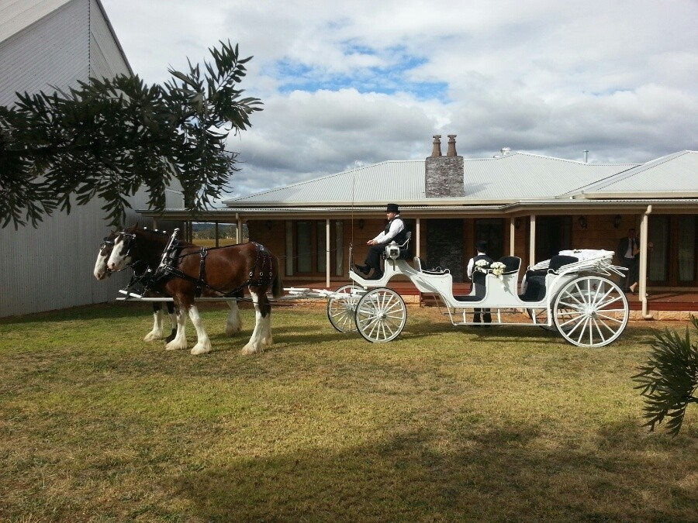
Linden Homestead –
Mudgee Wines Vineyard

Slide 2
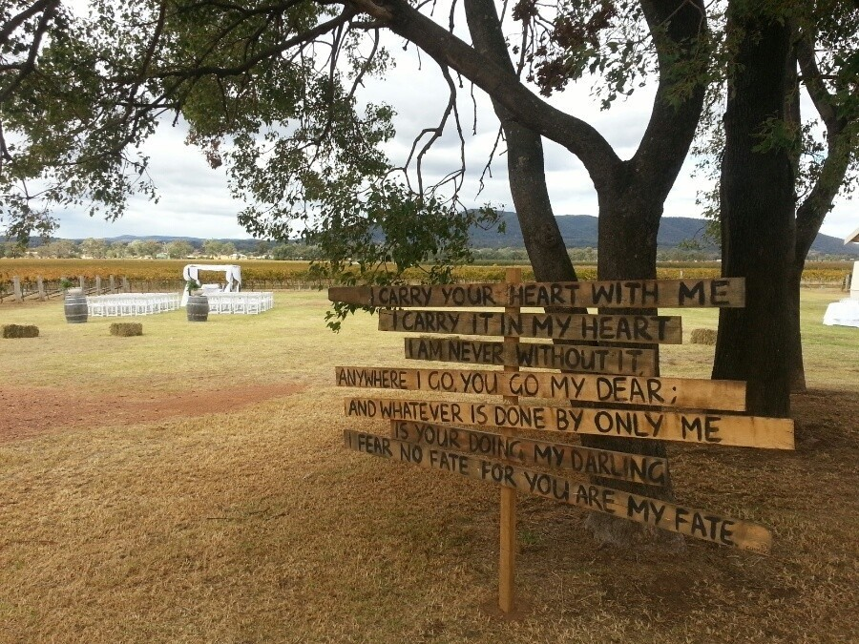
Wedding Ceremony almost the vines

Slide 3
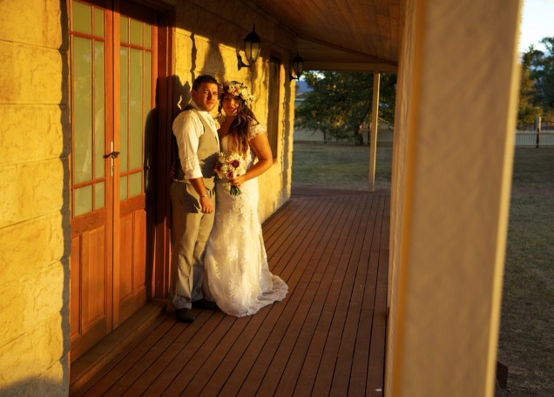

Slide 4
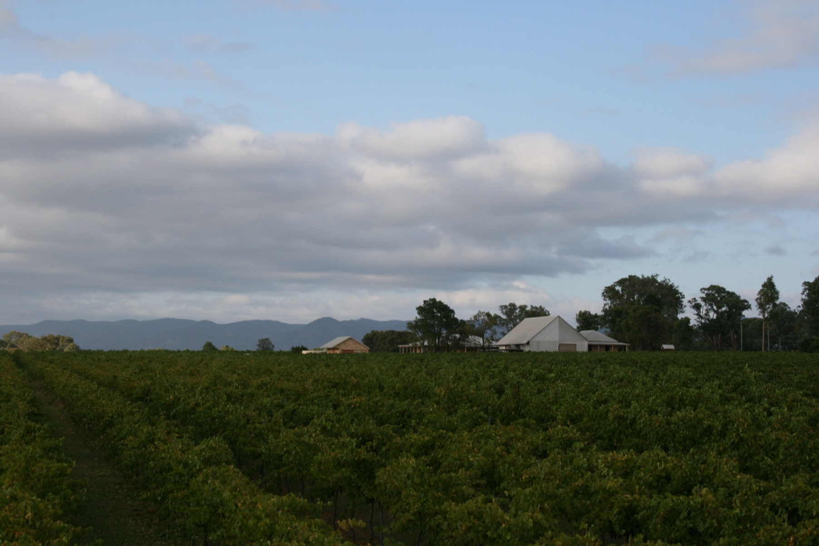

Slide 5
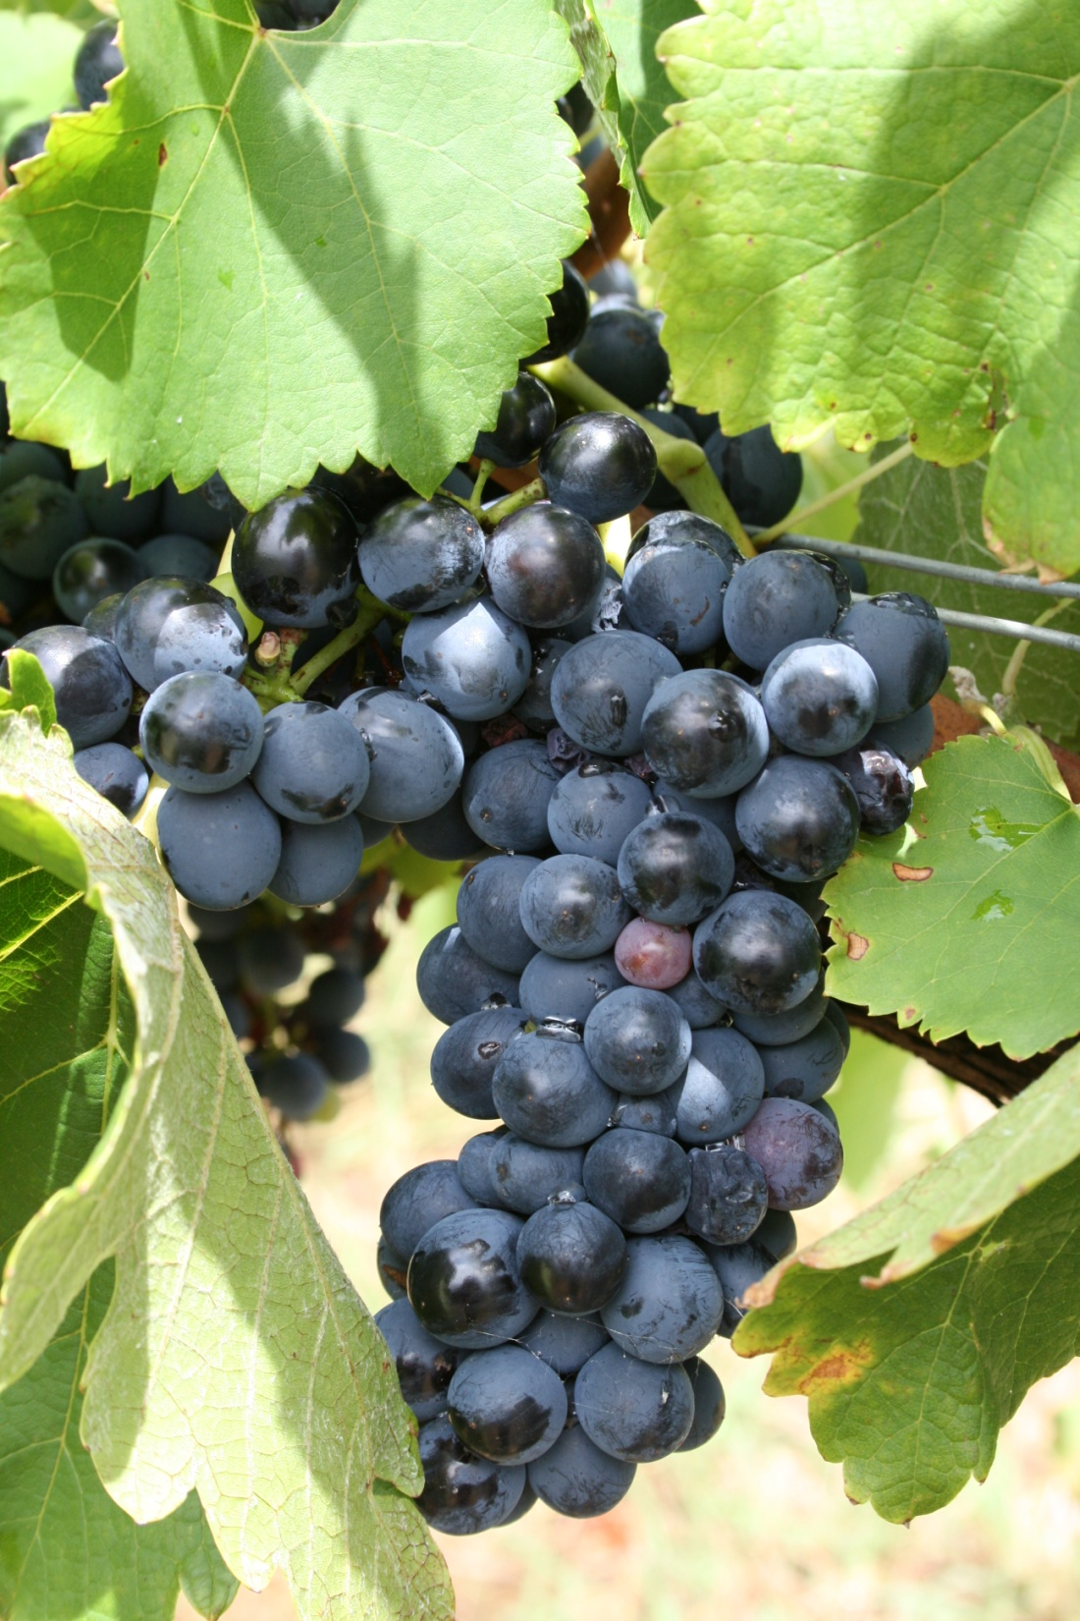
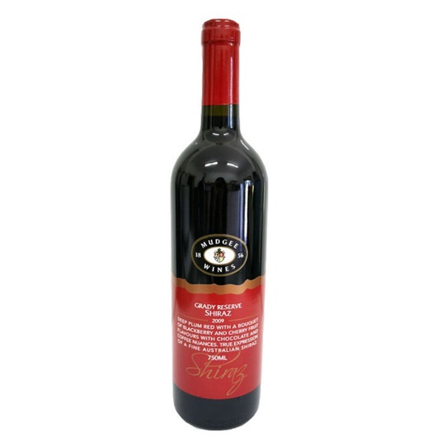
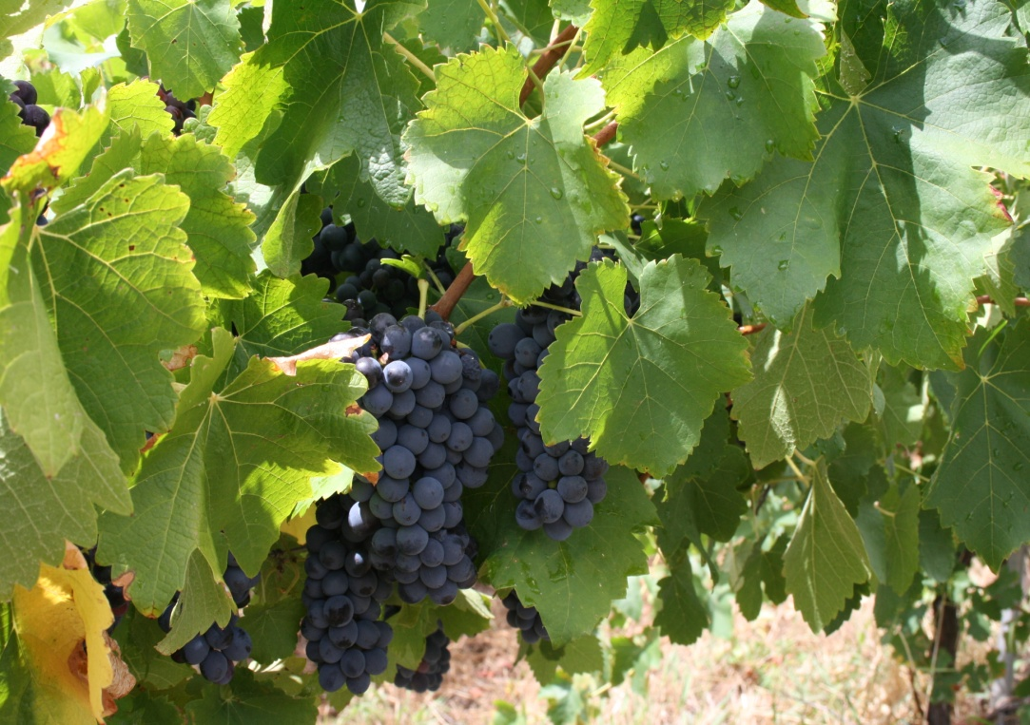
Mudgee Wines
Shiraz Grapes

Slide 6
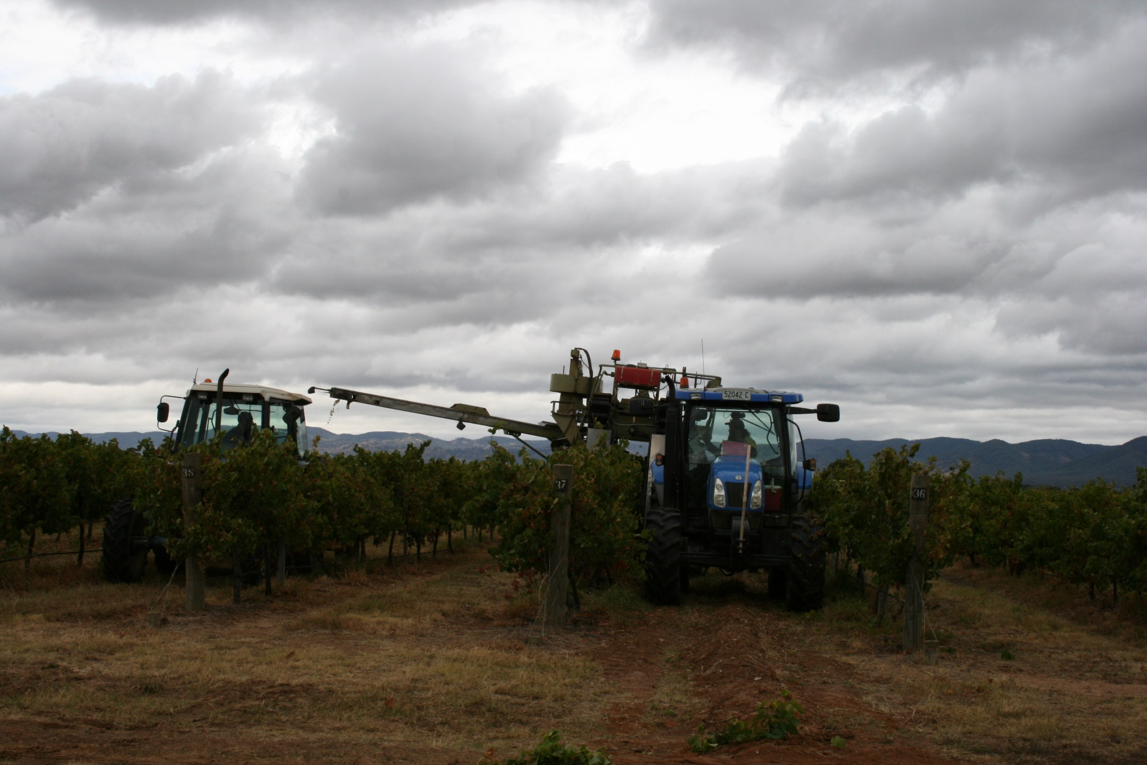
Mudgee Wines - Machine Harvest

Slide 7
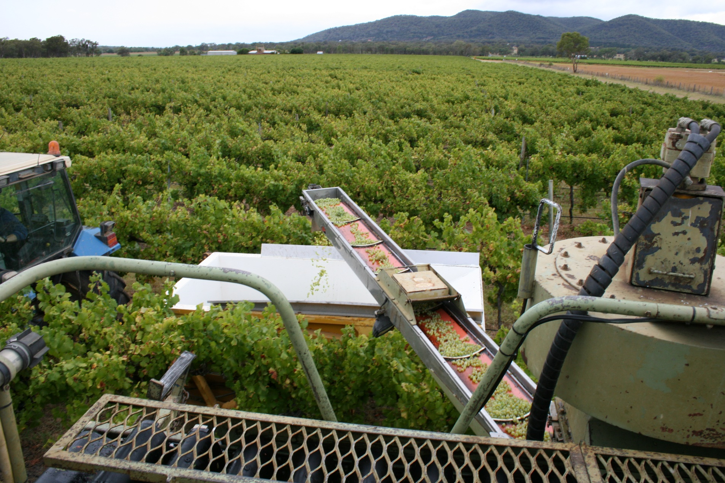

Slide 8
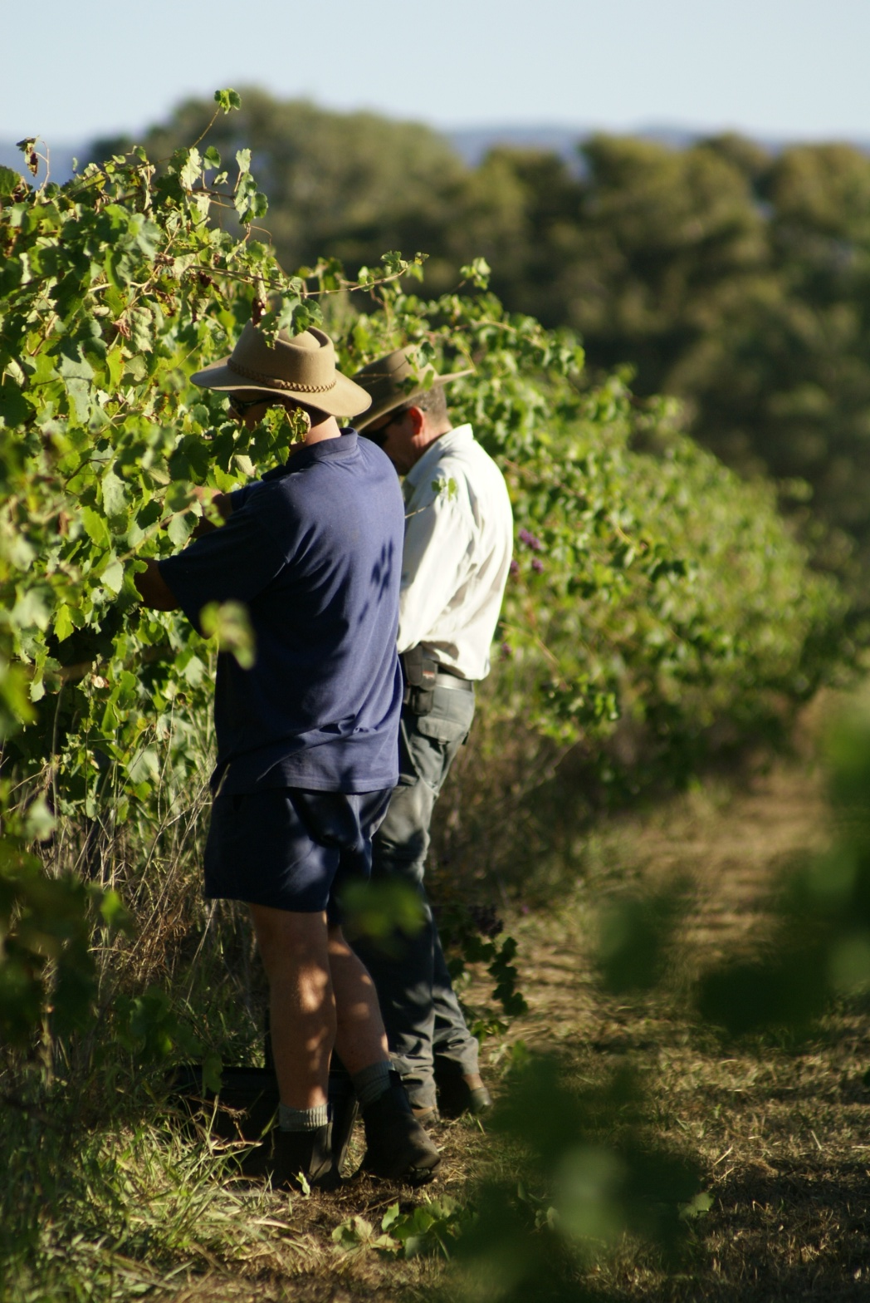
Mudgee Wines - Hand Picked

Slide 9
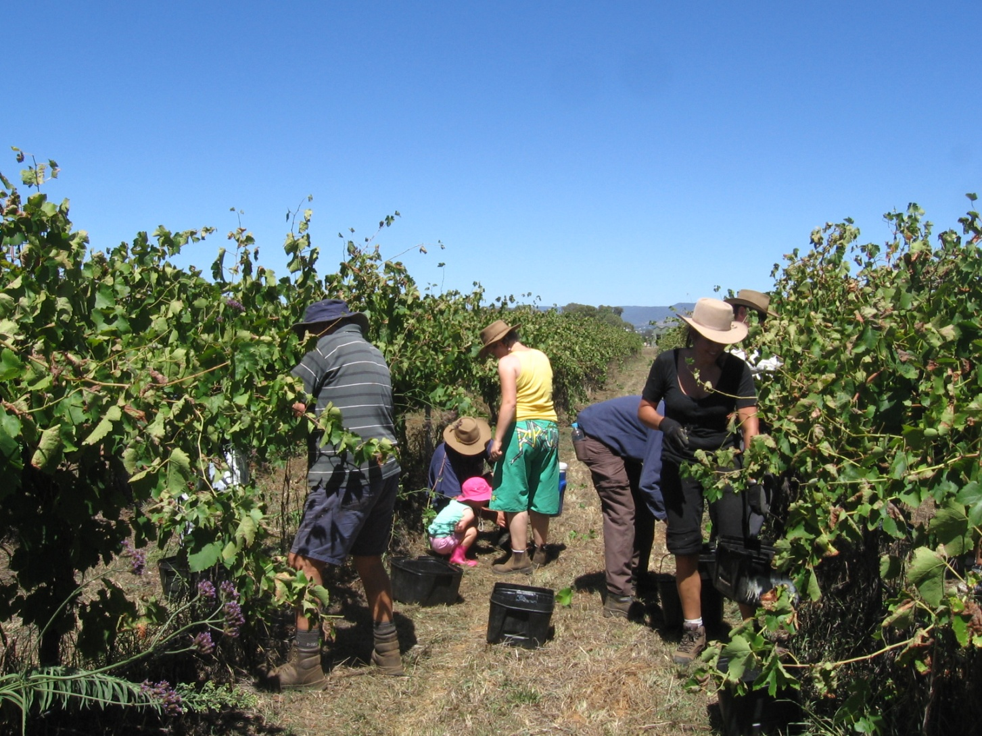

Slide 10
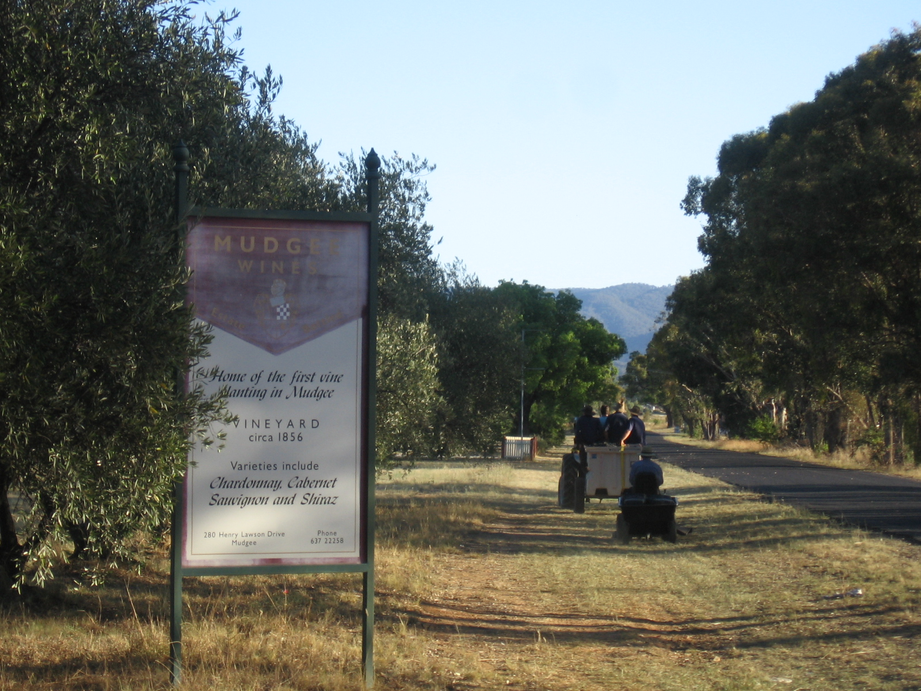

Slide 11
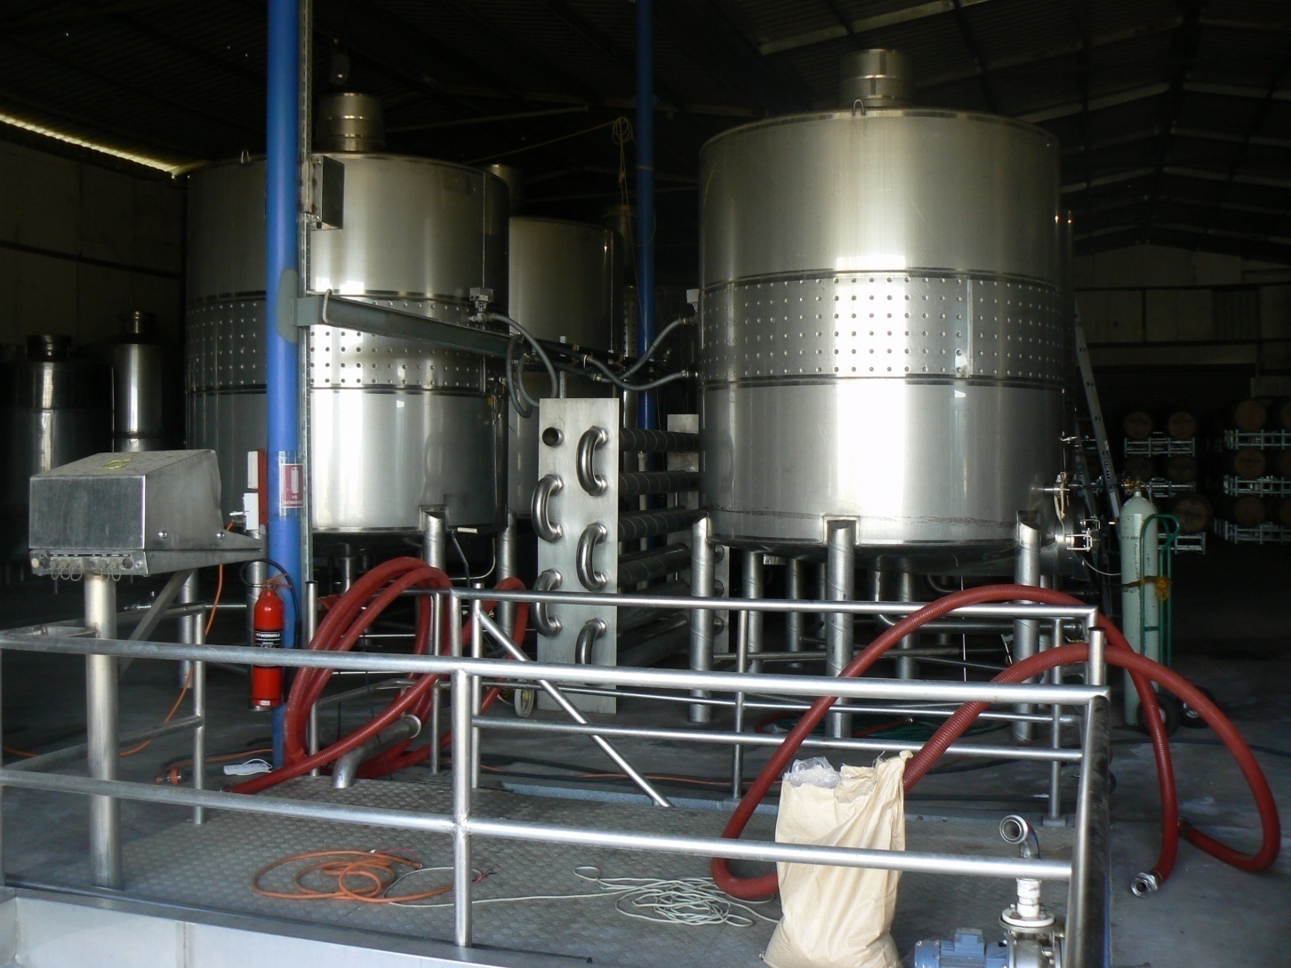
Mudgee Wines - Crushing

Slide 12
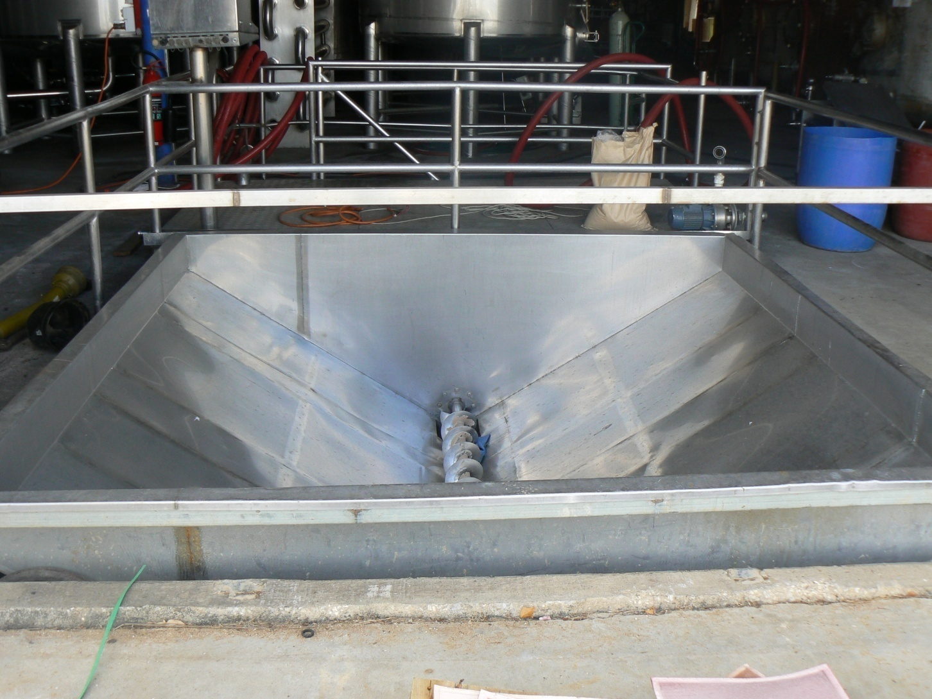
Crusher

Slide 13
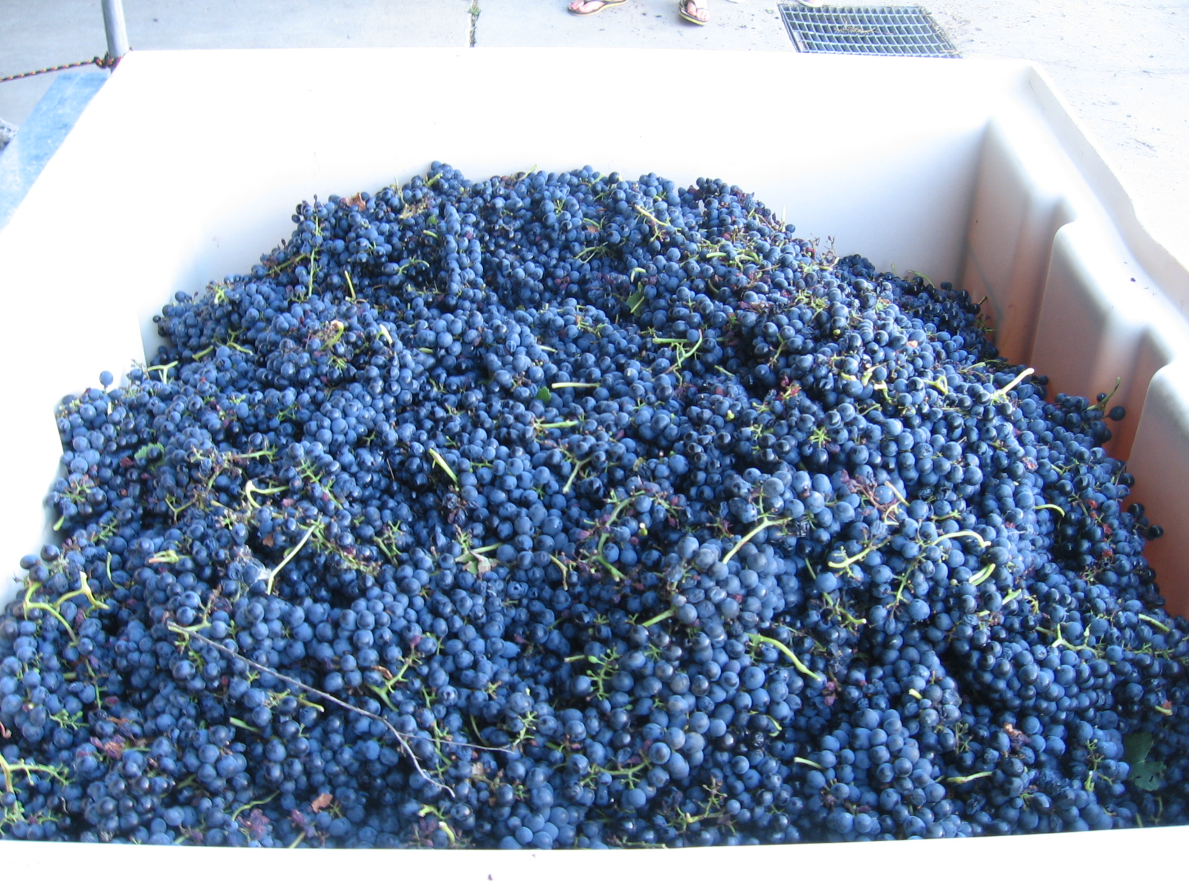

Slide 14
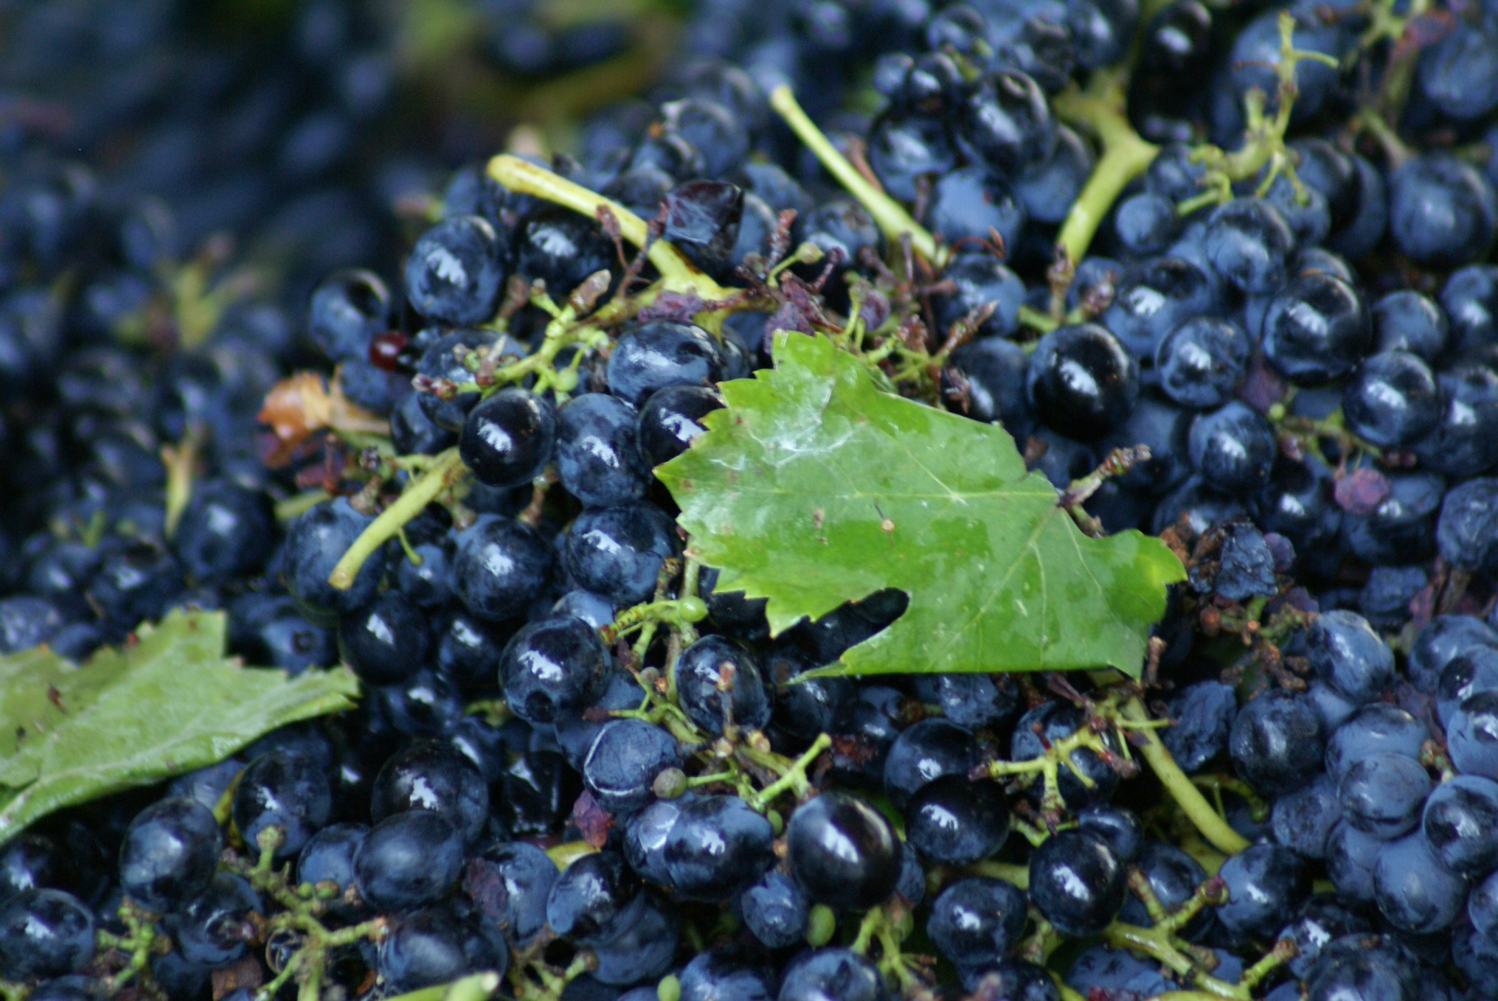

Slide 15
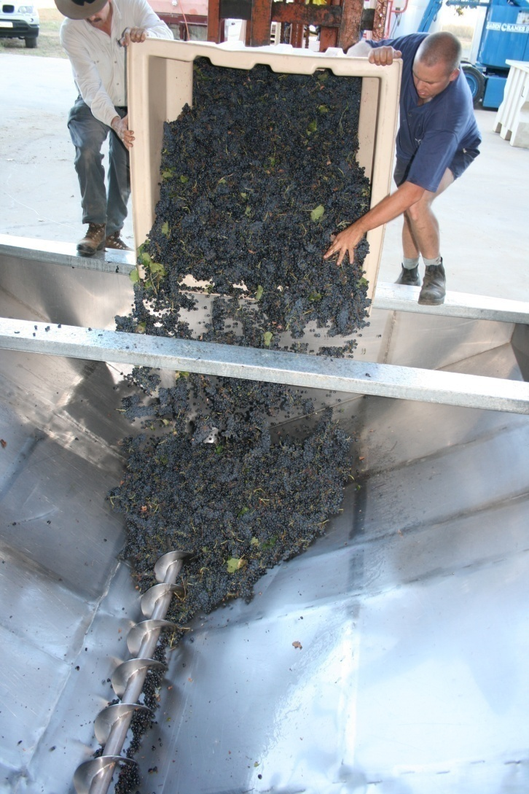
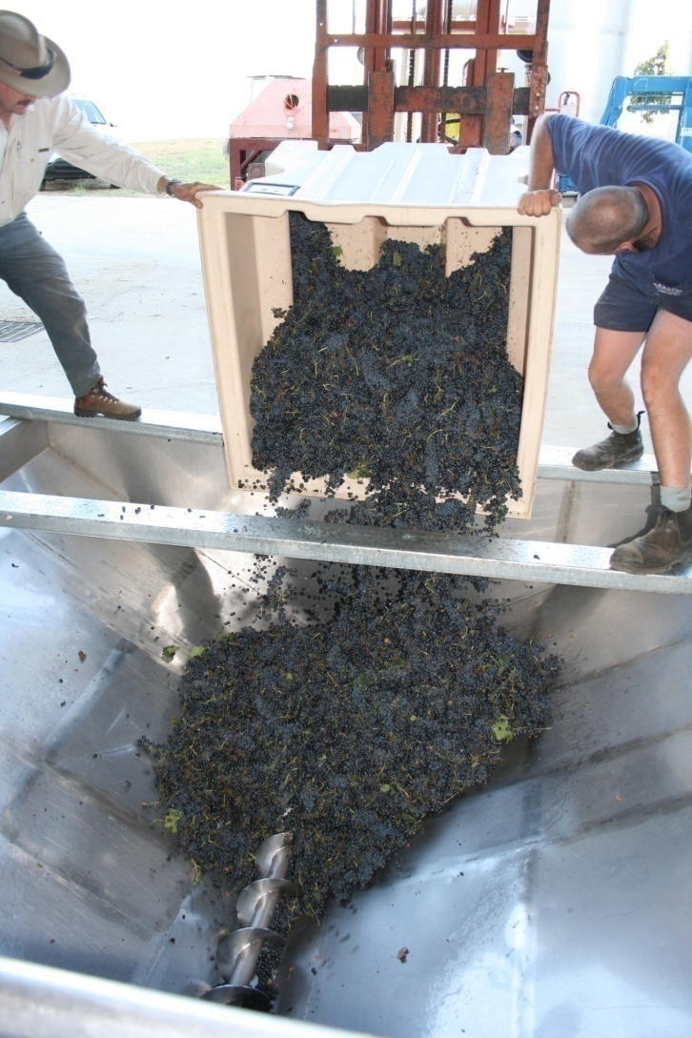

Slide 16
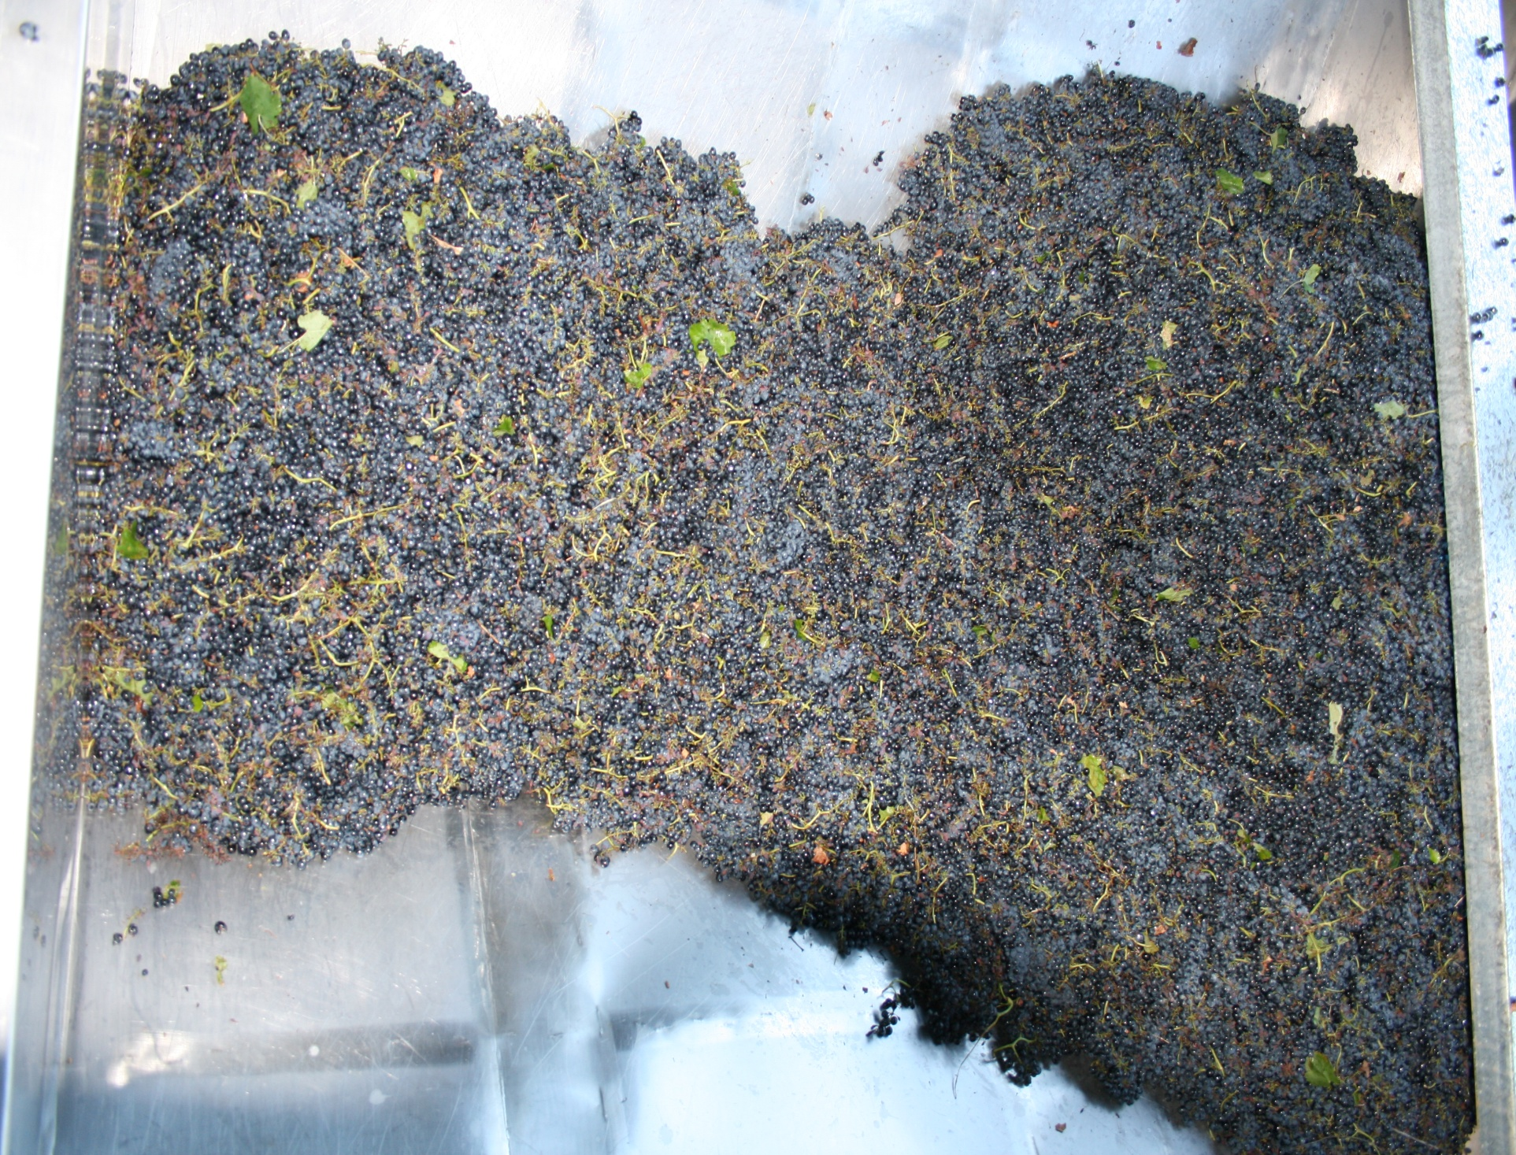

Slide 17
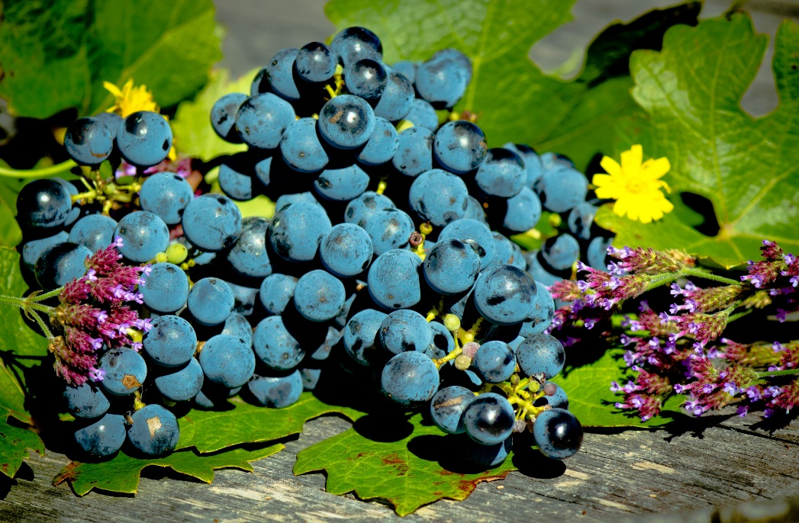
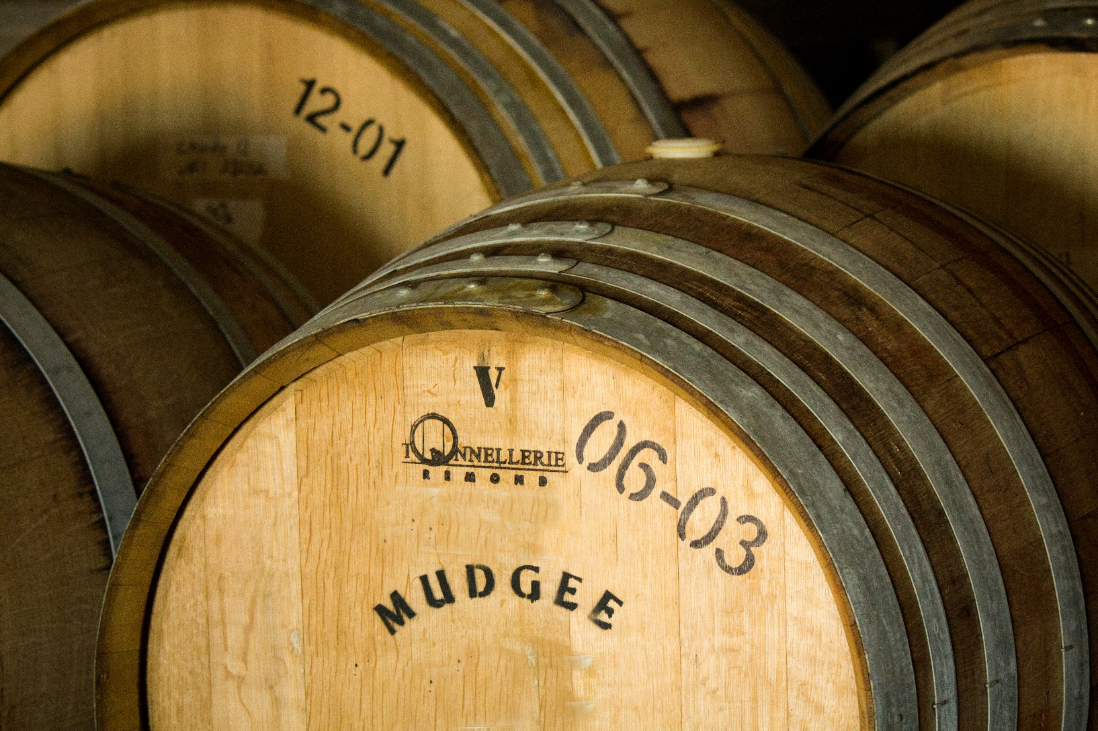

Slide 18
Wine produced by Mudgee Wines Estate

Slide 19
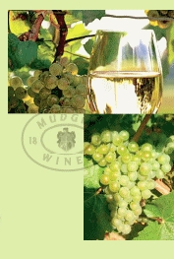
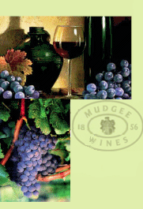
White Varieties produced:
Mudgee Wines Chardonnay
Mudgee Wines Verdelho
Mudgee Wines Pinot Grigio
Red Varieties Produced:
Mudgee Wines Cabernet Sauvignon
Mudgee Wines Shiraz
Mudgee Wines Durif
Mudgee Wines Merlot
Mudgee Wines Primitivo
Mudgee Wines Negro Amaro
Mudgee Wines Old Bush Vine Shiraz – Cabernet
Mudgee Wines Durif-Shiraz

Slide 20
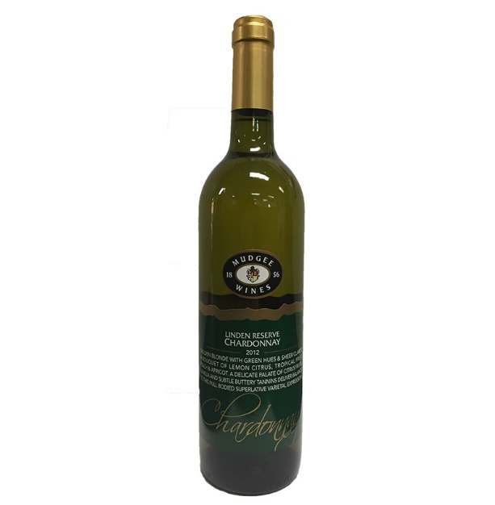
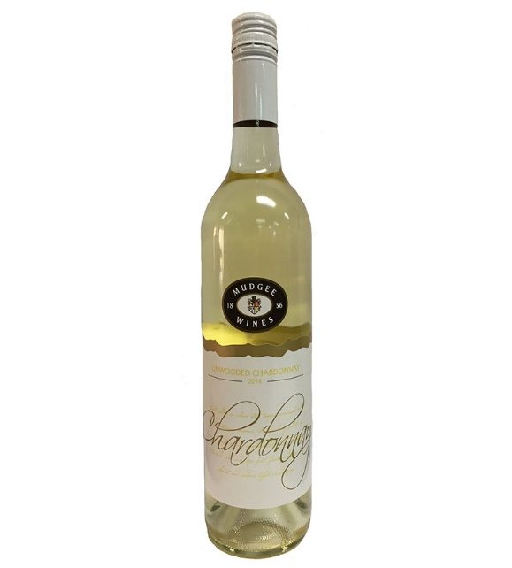
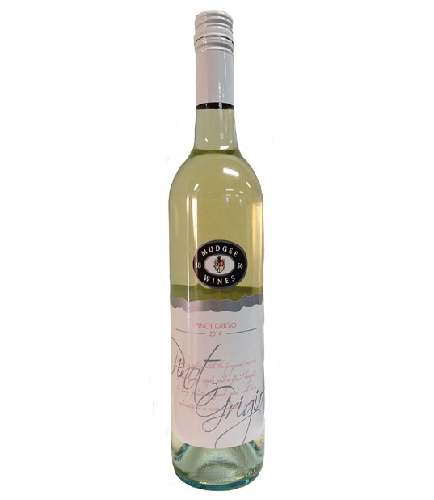
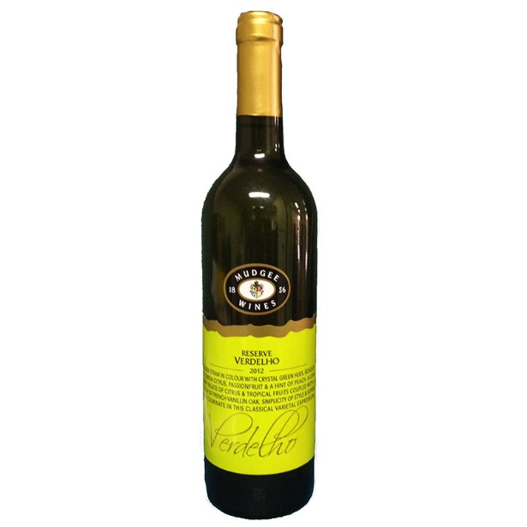
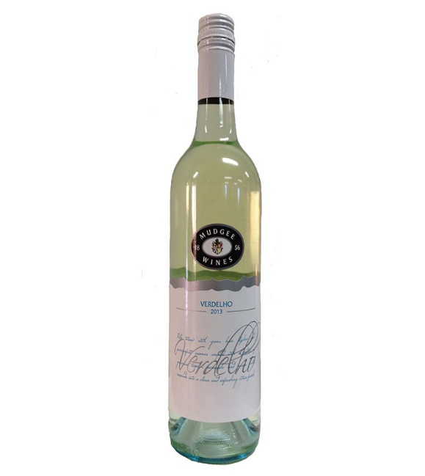
White Varieties

Slide 21
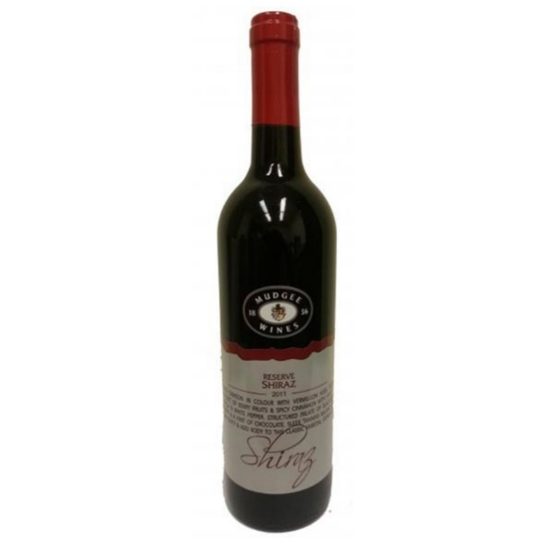
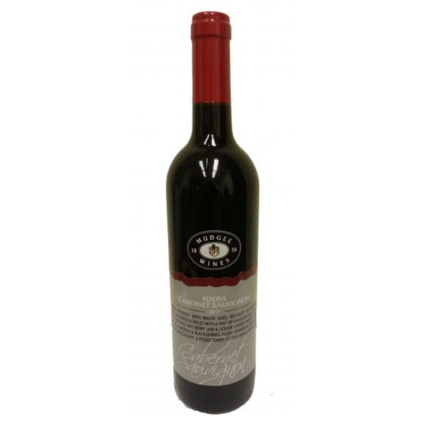
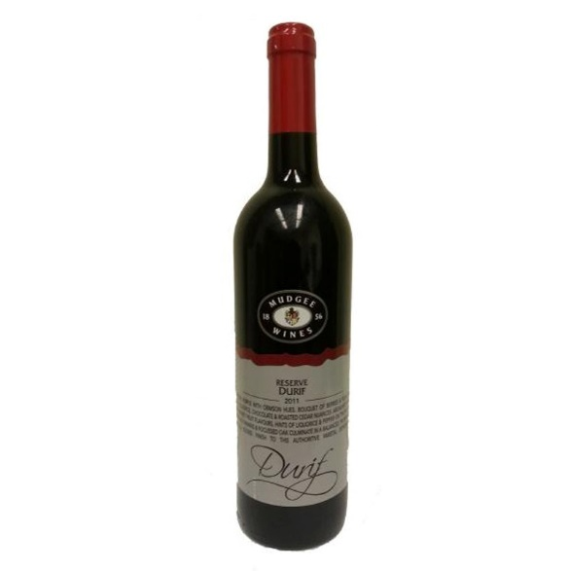
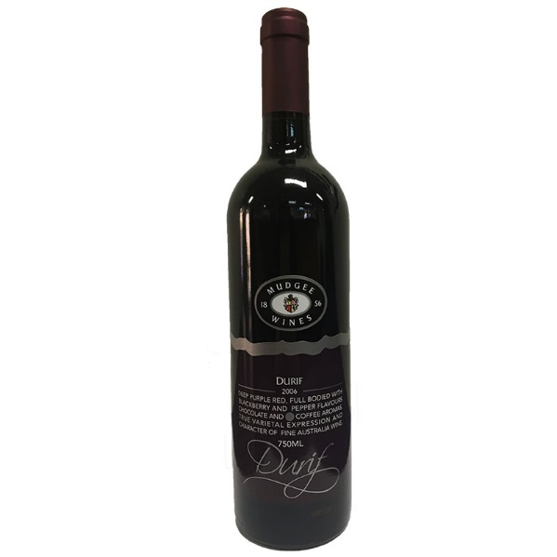
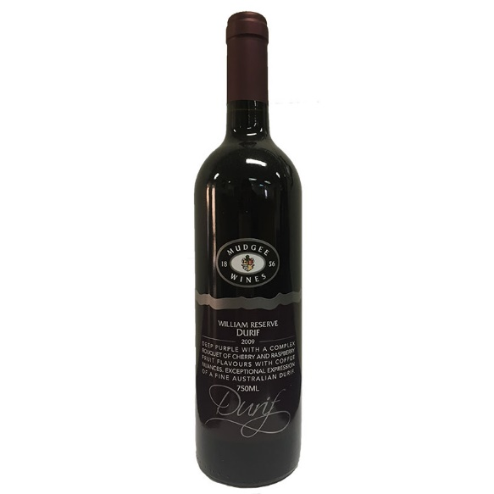
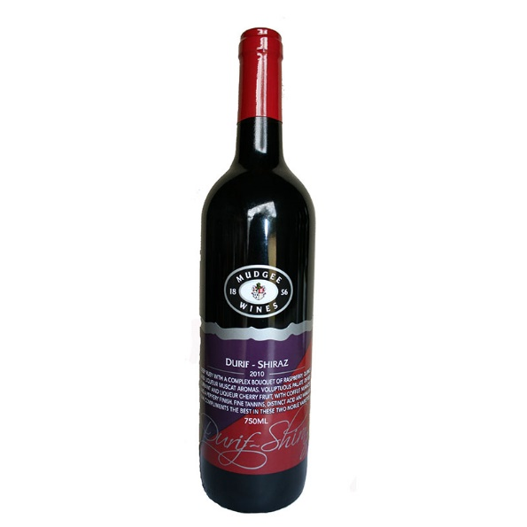
Mudgee Wines 2011 Grey Label
Reserve Shiraz Reserve Cabernet Sauvignon Reserve Durif
Mudgee Wines Durif
2006 Reserve Durif 2009 William Reserve Durif 2010 Reserve Durif-Shiraz

Slide 22
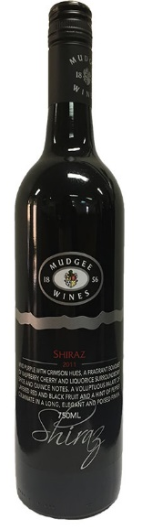

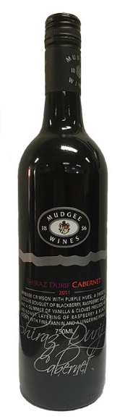
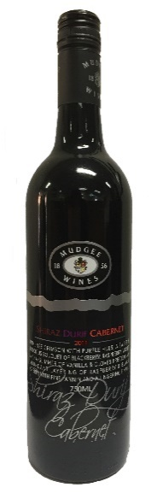
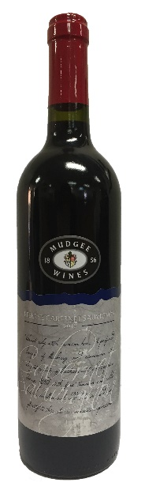
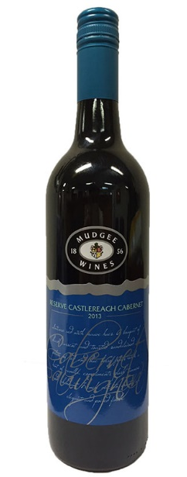
Mudgee Wines 2011 Black Label
Shiraz Cabernet Sauvignon Durif Shiraz Durif Cabernet
Mudgee Wines 2012 Reserve Label 2013 Reserve Label
Reserve Shiraz Reserve Cabernet Sauvignon 2013 Reserve Cabernet Sauvignon

Slide 23
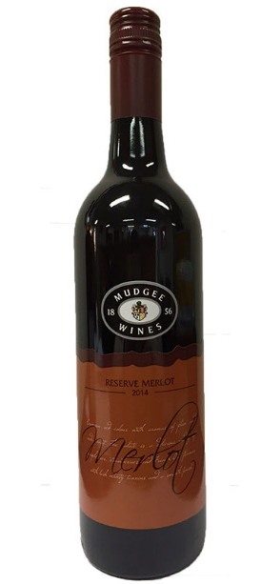
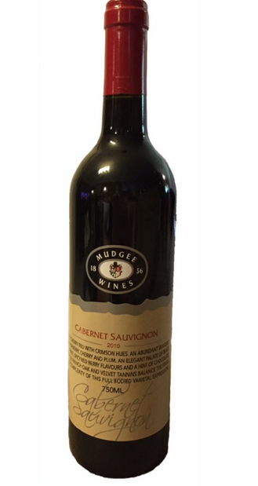
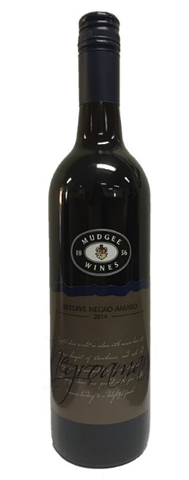
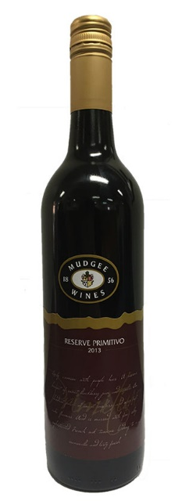
Mudgee Wines Other Varieties
2014 Reserve Merlot
2010 Reserve Cabernet
2014 Reserve Negro Amaro
2013 Reserve Primitivo

Slide 24
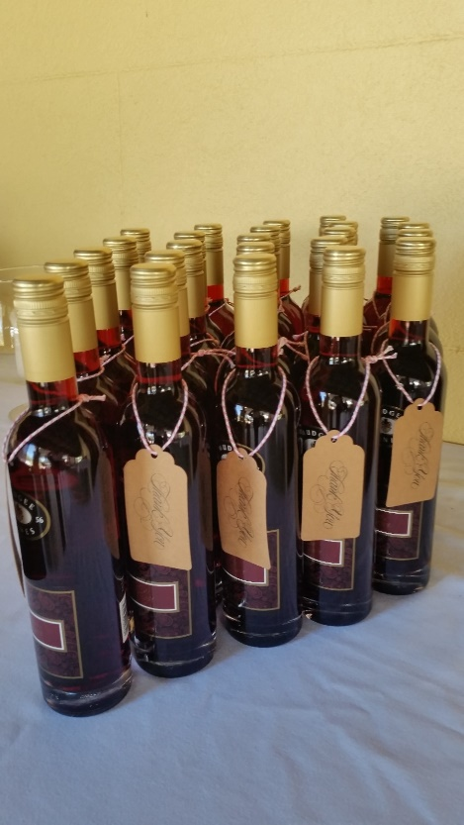
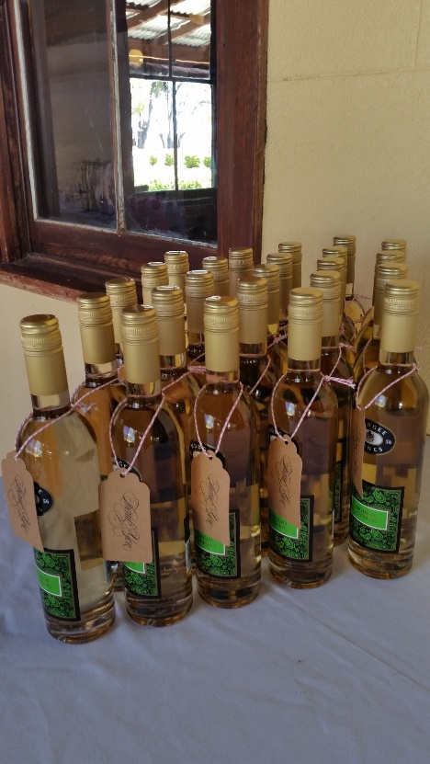
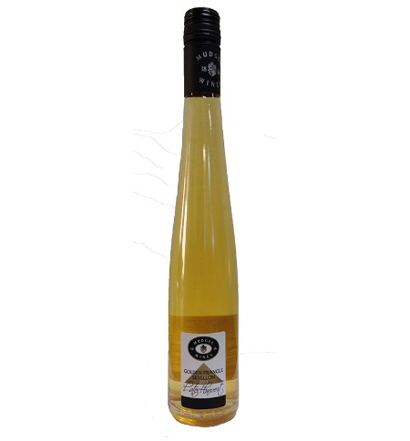
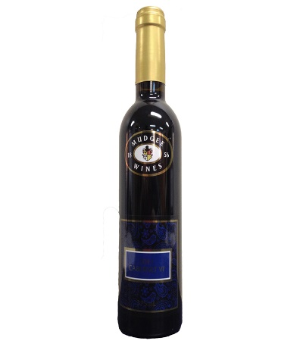
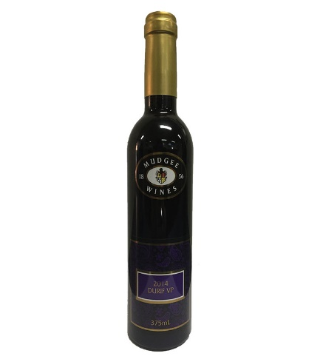
Ports and Liqueurs
Golden Triangle Dessert Wine
NV Ruby
Liqueur Verdelho
2011 Cabernet VP
2014 Durif VP

Slide 25
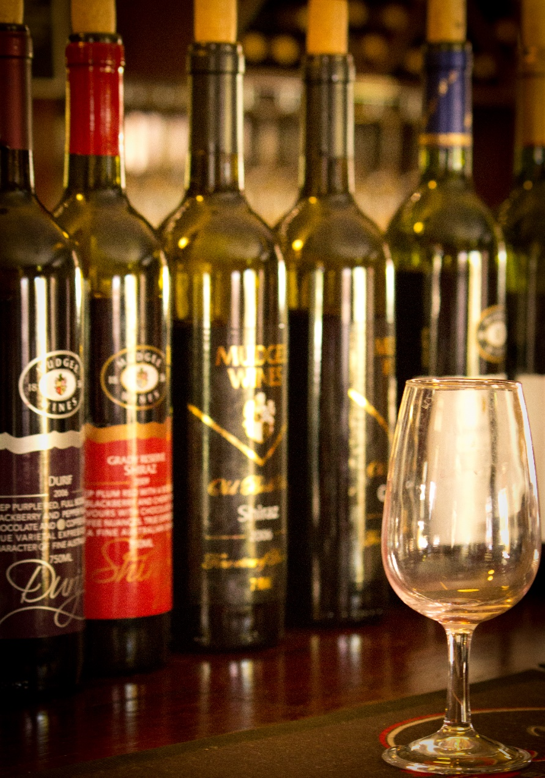
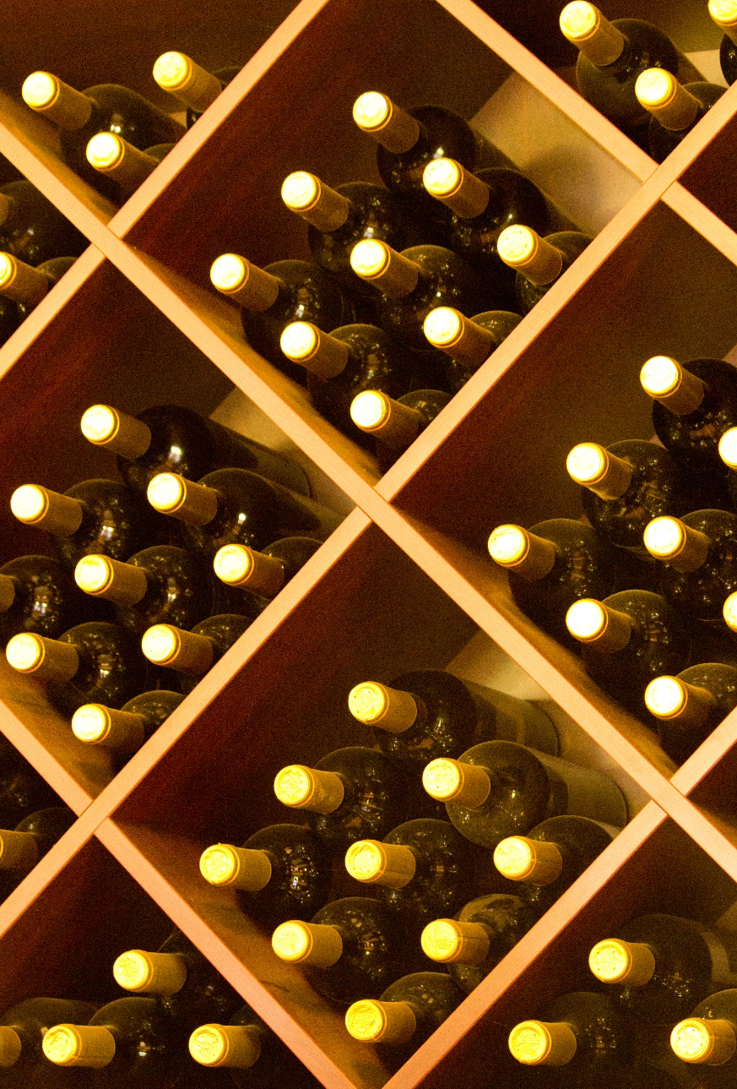

Slide 26


Slide 27

Mudgee Wines
Estate

Slide 28


Slide 29


“Steeped in heritage, Mudgee’s oldest vineyard offers you a taste of it’s legacy”
Mudgee Wines Winery and Vineyard

